Slide 1
Georgia Milestones Reporting Bay Creek Elementary Parent Meeting March 3, 2016

Slide 2
Georgia Milestones Assessment System
It is a comprehensive assessment system that measures how well students have learned the knowledge and skills outlined in the state-adopted content standards in English/Language Arts, mathematics, science, and social studies in grades 3-8 and high school.
It was developed to send a signal of college and career readiness. Students who achieve at the proficient level or higher have demonstrated that they are ready for their next endeavor.

Slide 3
College or Career Readiness
Georgia has defined College and Career Ready as students who are college or career ready are on-track to possess the English language arts/literacy/ mathematics knowledge and skills needed upon graduation to enter directly and succeed in
entry-level credit-bearing postsecondary courses, without the need for remedial coursework; or
job training and/or postsecondary education necessary for his/her chosen career (e.g., technical/vocational program, community college, apprenticeship or significant on-the-job training).
It is important to note that Georgia educators, university and technical college faculty, along with business and industry leaders from across Georgia, have worked to ensure that Georgia Milestones sends this signal.

Slide 4
With the new tests, comes many changes to the language we once knew….
3 levels of Performance: Did Not Meet Standards/ Meets Standards / Exceeds Standards
Passed the CRCT
800 / 850
5 days of CRCT testing (Reading, Language Arts, Mathematics, Science, and Social Studies)
5th Grade Writing Assessment
3rd Grade Writing Assessment
Only multiple choice questions
Forget all of these things. It is a new day in Georgia and a new day in testing with new and greater expectations for our students.

Slide 5
The Content Areas
Content Areas:
-English/Language Arts (includes Reading, ELA, and Writing components)
-2-day test
- Day 1 (60 – 75 minutes per section) & Day 2 (70 – 90 minutes)
-Multiple choice questions
-Open-ended questions
-Mathematics
-1-day test (60 – 85 minutes per section)
-Multiple choice questions
-Open-ended questions
-Science
-1-day test (45 – 70 minutes per section)
-Multiple choice questions
-Social Studies
-1-day test (45 – 70 minutes per section)
-Multiple choice questions

Slide 6
The Achievement Levels
Achievement Levels (4 Levels):
Beginning Learners (Level 1) do not yet demonstrate proficiency in the knowledge and skills necessary at this grade level/course of learning, as specified in Georgia’s content standards. The students need substantial academic support to be prepared for the next grade level or course and to be on track for college and career readiness.
Developing Learners (Level 2) demonstrate partial proficiency in the knowledge and skills necessary at this grade level/course of learning, as specified in Georgia’s content standards. The students need additional academic support to ensure success in the next grade level or course and to be on track for college and career readiness.
Proficient Learners (Level 3) demonstrate proficiency in the knowledge and skills necessary at this grade level/course of learning, as specified in Georgia’s content standards. The students are prepared for the next grade level or course and are on track for college and career readiness.
Distinguished Learners (Level 4) demonstrate advanced proficiency in the knowledge and skills necessary at this grade level/course of learning, as specified in Georgia’s content standards. The students are well prepared for the next grade level or course and are well prepared for college and career readiness.

Slide 7
End-of-Grade Scale Score Ranges
Content Area | Grade | Lowest Obtainable Scale Score (LOSS) | Developing Learner Cut Score | Proficient Learner Cut Score | Distinguished Learner Cut Score | Highest Obtainable Scale Score (HOSS)
English Language Arts | Grade 3 | 180 | 475 | 525 | 581 | 830
 | Grade 4 | 210 | 475 | 525 | 574 | 775
 | Grade 5 | 210 | 475 | 525 | 587 | 760
 | Grade 6 | 140 | 475 | 525 | 599 | 820
 | Grade 7 | 165 | 475 | 525 | 592 | 785
 | Grade 8 | 225 | 475 | 525 | 581 | 730
Mathematics | Grade 3 | 290 | 475 | 525 | 580 | 705
 | Grade 4 | 270 | 475 | 525 | 585 | 715
 | Grade 5 | 265 | 475 | 525 | 580 | 725
 | Grade 6 | 285 | 475 | 525 | 580 | 700
 | Grade 7 | 265 | 475 | 525 | 580 | 740
 | Grade 8 | 275 | 475 | 525 | 579 | 755
Science | Grade 3 | 275 | 475 | 525 | 566 | 695
 | Grade 4 | 230 | 475 | 525 | 578 | 730
 | Grade 5 | 160 | 475 | 525 | 595 | 780
 | Grade 6 | 175 | 475 | 525 | 610 | 780
 | Grade 7 | 215 | 475 | 525 | 589 | 745
 | Grade 8 | 165 | 475 | 525 | 593 | 785
Social Studies | Grade 3 | 275 | 475 | 525 | 560 | 680
 | Grade 4 | 250 | 475 | 525 | 570 | 700
 | Grade 5 | 290 | 475 | 525 | 555 | 665
 | Grade 6 | 295 | 475 | 525 | 560 | 670
 | Grade 7 | 280 | 475 | 525 | 564 | 685
 | Grade 8 | 240 | 475 | 525 | 572 | 715

Slide 8
So why the changes?
Georgia had some of the lowest achievement EXPECTATIONS in the nation;
Needed to provide a “truer” picture of student achievement;
State of Georgia was portrayed as a state with one of the largest “honesty gaps” based on the information provided in its former testing programs;
Georgia Milestones provides a more accurate view of where we are as a state and where we need to focus our attention to ensure that all students are successful and can compete with their peers from across the nation.

Slide 9
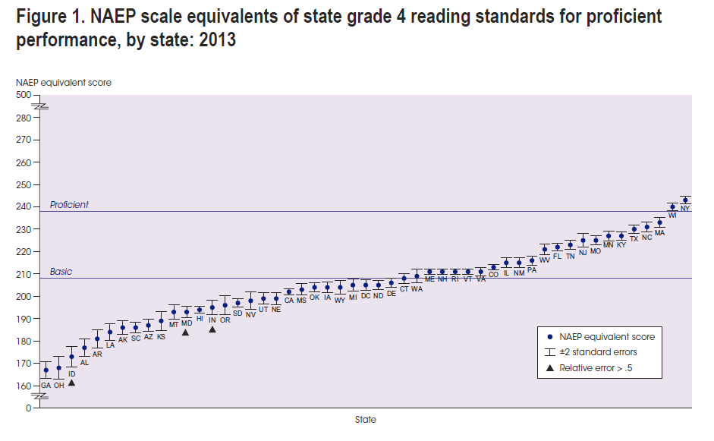
Grade 4 Reading: CRCT vs NAEP

Slide 10
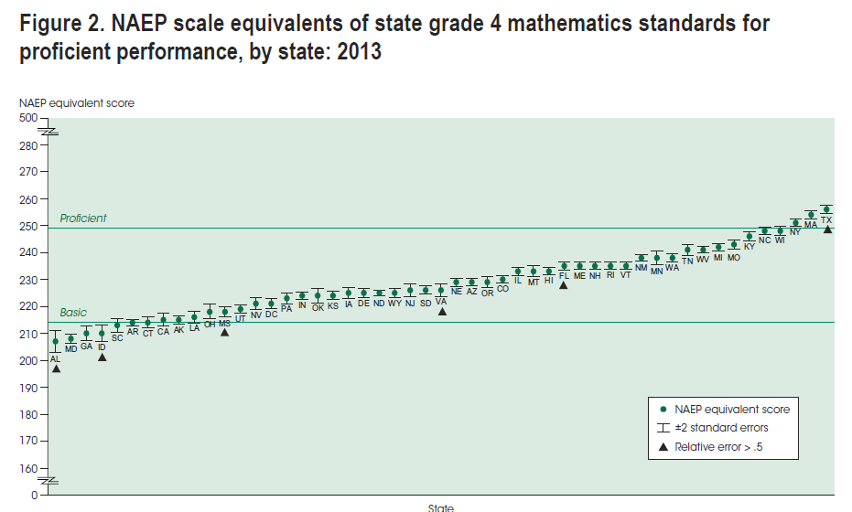
Grade 4 Mathematics: CRCT vs NAEP

Slide 11
College-Readiness
Reading
SAT – Class of 2013: 43%
SAT – Class of 2014: 44%
SAT – Class of 2015: 44%
ACT – Class of 2013: 43%
ACT – Class of 2014: 41%
ACT – Class of 2015: 46%
PSAT – 2012 Sophomores: 40% on track to be CCR
PSAT – 2013 Sophomores: 30% on track to be CCR

Slide 12
College-Readiness
Mathematics
SAT – Class of 2013: 42%
SAT – Class of 2014: 44%
SAT – Class of 2015: 42%
ACT – Class of 2013: 38%
ACT – Class of 2014: 44%
ACT – Class of 2015: 38%
PSAT – 2012 Sophomores: 37% on track to be CCR
PSAT – 2013 Sophomores: 35% on track to be CCR

Slide 13
Elementary Policy Uses for 2016: Georgia Milestones
The End of Grade (EOG) measures help determine promotion/retention status in grade 3 (reading) and grade 5 (reading and mathematics).
A reading score is provided to inform promotion status. A retest will be administered in the content area of ELA for those who require a retest.
For mathematics, students in the Beginning Learner Achievement Level require a retest (grade 5).
Informs Georgia’s accountability measures (CCRPI, Growth, Educator Effectiveness)
Provides a college and career readiness signal

Slide 14
Promotion/Retention Policy
The section of the promotion/retention policy tied to state-adopted assessments only applies to students in grades 3, 5, and 8. Students in these grade levels must meet the following assessment requirements:
Third graders must achieve grade level in reading only;
Fifth and eighth grade students must achieve grade level in reading and achieve at least at the Developing Learner achievement level (level 2) in math.
NOTE: No longer is the promotion/retention determination solely based on a scale score (number) as in previous years.

Slide 15
Promotion/Retention Policy
What happens if my 3rd grader misses the ELA test (and doesn’t receive a reading status) or my 5th grader misses the ELA test and/or the Math test in April or does not achieve the assessment promotion requirements?
Your student will be required to participate in the retests that will be administered in the summer.
3rd and 5th grade students who need to demonstrate grade level reading will take the ELA retest (a two-day test) on Monday, June 6 and Tuesday, June 7
5th grade students who need to achieve at least at the Developing Learner level in math will take the Math retest on Wednesday, June 8.
Transportation will be provided.

Slide 16
Promotion/Retention Policy
What if my student still does not achieve at the required levels on the retest(s)?
Within 24 hours of the results being received in the district, phone calls will be placed to parents. In addition, letters will be mailed.
Parents will have 10 days to respond and request a placement meeting if they do not wish to have their student retained.
Placement meetings include the parent, principal (or principal designee), and a teacher. This group, using test scores and other supporting evidence, will make the promotion or retention decision. In order for the student to be “placed” in the next grade level, the decision must be unanimous.

Slide 17
Policy Uses: Promotion/Retention
If the promotion/retention policy had not been waived in 2014-15, the number of retesters would have been….
Subject/Grade Level | Bay Creek | State
Reading – 3rd | 25 | 40,860
Reading – 5th | 36 | 43,434
Math – 5th | 20 | 32,094

Slide 18
Overall, how did my student do on the Georgia Milestones and how do I read the student reports?
The Individual Student Report (ISR) provides information on your student’s overall performance for the content areas tested at the end of the grade for grades 3‐8.

Slide 19
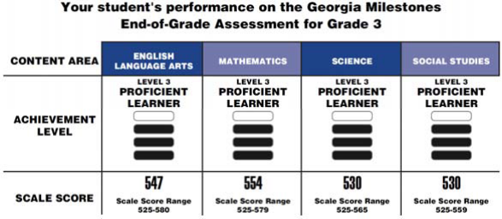
Page 1 of Report
1 CONTENT AREA: This shows you the subject area(s) in which your student was tested.
ACHIEVEMENT LEVEL: Milestones results are reported using four categories of achievement that
are represented with bar stacks. In previous state tests, achievement was reported in three categories
(Does Not meet, Meets, and Exceeds). Under the new system of reporting, proficiency is the target.
Achievement Level Table
3 SCALE SCORE: A scale score is the total number of correct answers converted to a consistent and standardized scale across different forms of the test. Within each range of scores, achievement will fall in one of four achievement levels. The scale score range varies from subject to subject and grade to grade based on the actual test.
BEGINNING LEARNER Student does not yet demonstrate proficiency | These students need substantial academic support to be prepared for the next grade level. (When these assessments are used to determine promotion in 5th grade mathematics, students in this level will not be promoted to the next grade level).
DEVELOPING LEARNER Student demonstrates partial proficiency | These students need additional academic support to ensure success in the next grade level.
PROFICIENT LEARNER Student demonstrates proficiency | These students are prepared for the next grade level and are considered to be on track for college and career readiness.
DISTINGUISHED LEARNER Student demonstrates advanced proficiency | These students are well-prepared for the next grade level and are well-prepared for college and career readiness.

Slide 20
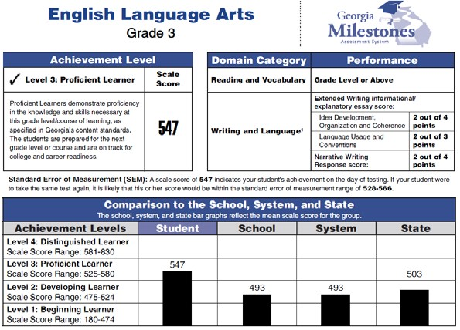
How do I read my student’s English/Language Arts (ELA) results?
Page 3 of Report
4 This section gives a summary of your student’s achievement in ELA.
5 This section details your student’s performance on the Reading and Vocabulary portions of the test. IMPORTANT: In grades 3, 5, and 8, this result is used to determine promotion/retention status in reading. “Below Grade Level” signals that the promotion requirement has not been met.
6 This section details your student’s performance on the Writing and Language portions of the test. This section shows how many points a student earned out of a total for the different components assessed in the essay.
7 The Comparison chart shows scale score ranges for each achievement level and how your student’s score compares to averages for the school, the school district, and the state.

Slide 21
Page 3 of Report
How do I find appropriate grade level reading material for my student?
8 Lexile information measures a student’s reading ability. The Lexile measure indicates that the student has the ability to read books at this level with 75% reading comprehension. Many books have a Lexile measure, allowing you to use this score to identify books that are at an appropriate reading level for your student as well as to provide some challenge to improve their reading skills. Please note that when looking for suggested titles based on a Lexile score, you should factor in a student’s age and interests. Your student’s teacher can provide additional age‐appropriate suggestions to match and to stretch your student as a reader.

Slide 22
Pages 4-6 of Report
How do I read my student’s results in other subject areas?
9 This section gives a summary of your student’s achievement in the subject tested. In this example, it is a summary of Mathematics for a 3rd grader. The Science and Social Studies pages are similar.
10 The “Domain Category” is the area of focus tested in the subject area for a particular grade level, for example, Geometry in Mathematics, Geography in Social Studies, or Cells in Science.
11 The “Performance” information lets you know how your student did in that area of focus. The level of fill in the circle indicates your student’s level of mastery. For Mathematics, Science, and Social Studies, these results are reported as:
Remediate Learning (lowest level of performance)
Monitor Learning (acceptable level of performance)
Accelerate Learning (highest level of performance)
Teachers will use this information to determine if a student needs additional time and opportunities to master a
topic or if the student has mastered it and is ready to tackle more advanced concepts.

Slide 23
Pages 3-6 of Report
What is the National Percentile?
The EOG assessment included a small number of questions in each content area that are used on a nationally norm‐referenced test, TerraNova. This information provides a general snapshot of how a student’s answers compare to a national sample of students in the same grade. In this example, the student had a national percentile ranking of 62. This means that the student scored better than 62% of students in the same grade who tested on the same subset of TerraNova items.
IMPORTANT NOTE: This national percentile ranking may not be used as a measure for program identification (such as gifted). It is only a barometer designed to provide an indication of a student’s relative performance compared to peers nationally.

Slide 24
Taking a look at results in the baseline year: 2014-15

Slide 25
Grade 3 – English/Language Arts
Due to rounding, percentages may not total 100%.

Slide 26
Grade 3 - Mathematics
Due to rounding, percentages may not total 100%.

Slide 27
Grade 3 - Science
Due to rounding, percentages may not total 100%.

Slide 28
Grade 3 – Social Studies
Due to rounding, percentages may not total 100%.

Slide 29
Grade 4 – English/Language Arts
Due to rounding, percentages may not total 100%.

Slide 30
Grade 4 - Mathematics
Due to rounding, percentages may not total 100%.

Slide 31
Grade 4 - Science
Due to rounding, percentages may not total 100%.

Slide 32
Grade 4 – Social Studies
Due to rounding, percentages may not total 100%.

Slide 33
Grade 5 – English/Language Arts
Due to rounding, percentages may not total 100%.

Slide 34
Grade 5 - Mathematics
Due to rounding, percentages may not total 100%.

Slide 35
Grade 5 - Science
Due to rounding, percentages may not total 100%.

Slide 36
Grade 5 – Social Studies
Due to rounding, percentages may not total 100%.

Slide 37
Bay Creek Highlights: Georgia Milestones Percentage-Point Comparison to System, RESA, & State
Grade/ Content | Distinguished |  |  | Proficient & Above |  |  | Developing & Above
 | System | RESA | State | System | RESA | State | System | RESA | State
3rd ELA | -2 | Same | +1 | +6 | +11 | +14 | +4 | +8 | +12
3rd Math | +1 | -1 | Same | +16 | +18 | +24 | +6 | +7 | +12
3rd Sci | +5 | +3 | +5 | +8 | +11 | +16 | +7 | +9 | +13
3rd SS | +11 | +10 | +12 | +9 | +9 | +13 | +5 | +7 | +11
4th ELA | +12 | +15 | +15 | +18 | +25 | +27 | +6 | +11 | +14
4th Math | +5 | +5 | +7 | +8 | +10 | +14 | +10 | +9 | +14
4th Sci | -3 | -3 | -3 | +4 | +6 | +10 | +8 | +10 | +15
4th SS | +9 | +9 | +11 | +21 | +23 | +27 | +11 | +12 | +17
5th ELA | +2 | +4 | +4 | +8 | +13 | +15 | +2 | +7 | +9
5th Math | Same | -1 | Same | +6 | +7 | +11 | +6 | +7 | +11
5th Sci | -1 | -1 | Same | +1 | +4 | +9 | +2 | +2 | +8
5th SS | +7 | +7 | +9 | +10 | +13 | +18 | +8 | +10 | +15

